Slide 1
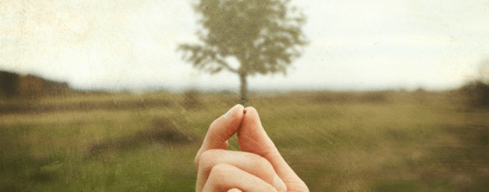
Disciples are Willing to ASK

Slide 2
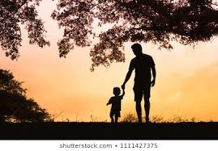
“How do I do this??”
Mark 9: 14- 32
“Teacher, I brought you my son.”
“IF you can do anything, HELP US.”
But none of this would have happened if the father had not been brave enough to ASK for help.

Slide 3
The disciples ASK Jesus, “Why couldn’t we cast it out?”
only through prayer and fasting
through prayer = staying connected to the source
fasting = which means being a willing vessel. Opening the way for the Father to work through you.

Slide 4
Asking Questions turns our FEAR into FAITH

Slide 6
Gideon: from Hiding to Seeking
When the angel of the Lord first met Gideon, he was hiding out in the winepress
After his time in the Presence of the Lord, he is seeking out the enemy to destroy them.

Slide 7
The key to walking as a man or woman or CHILD of valor and courage and victory is to always remember that God is with you!

Slide 9
²⁹ Confused and disturbed, Mary tried to think what the angel could mean. ³⁰ “Don’t be afraid, Mary,” the angel told her, “for you have found favor with God!

Slide 10
³⁸ Mary responded, “I am the Lord’s servant. May everything you have said about me come true.”

Slide 11
“Where shall we buy bread for these people to eat?”
Jesus asked this only to test them
for he already had in mind what he was going to do.

Slide 12
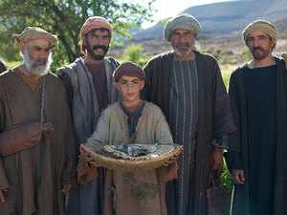
Andrew, Simon Peter’s brother, spoke up,⁹ “Here is a boy with five small barley loaves and two small fish, but how far will they go among so many?”

Slide 13
“Truly I tell you, unless you change and become like little children, you will never enter the kingdom of heaven. ⁴ Therefore, whoever takes the lowly position of this child is the greatest in the kingdom of heaven.”

